Slide 1

Divine Familial Terms
Topic 5

Slide 2
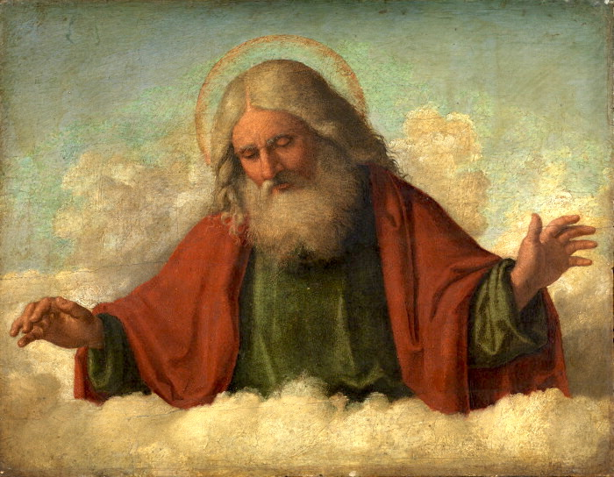

Divine Familial Terms Definition
God is the Father
Jesus is the Son

Slide 3
Some translators have done this
Beloved of God
or
One sent from God
Son of God

Slide 4
But the Bible Says:
God calls Himself “Father” to His “Son” Jesus & expresses Himself as The Father, Son and the Holy Spirit
1
He Himself was the sacrifice for our sins in the person of His Son
2

Slide 5

Consider the True Meaning
“The Father has sent the Son to be the Savior of the world.”
God sent his own Son to die for us.

Slide 6

Scriptural Examples
John 3:16
1 John 4:10
Matthew 3:17
Matthew 17:5

Slide 7

bibleineverylanguage.org

Slide 8


